Slide 1

Organization Architecture
Business environment as a network

Slide 2
Contents
Presentation
Team
Organization
Project
Modelling
Analysis
Questions

Slide 3


Presentation

Slide 4
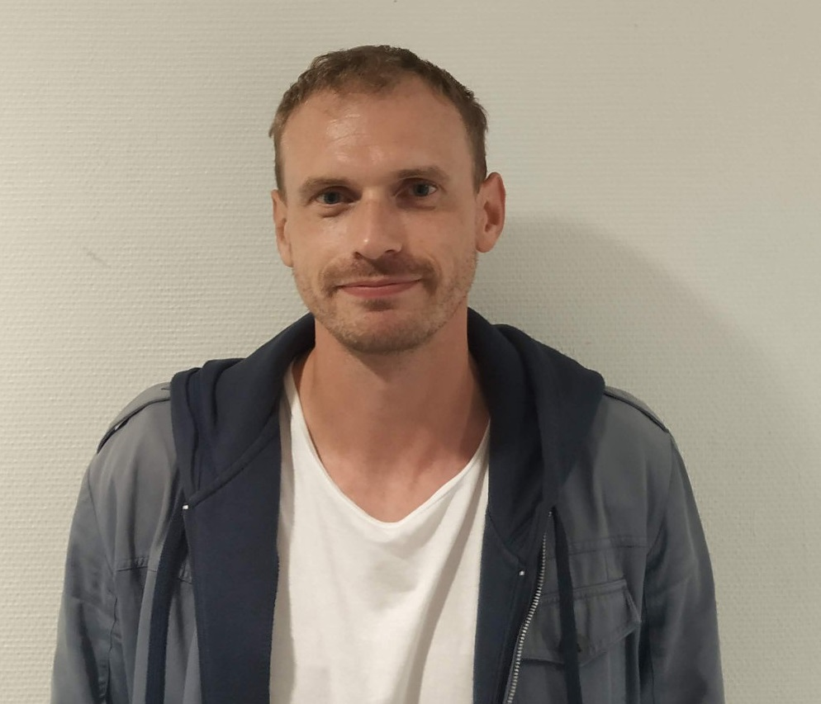

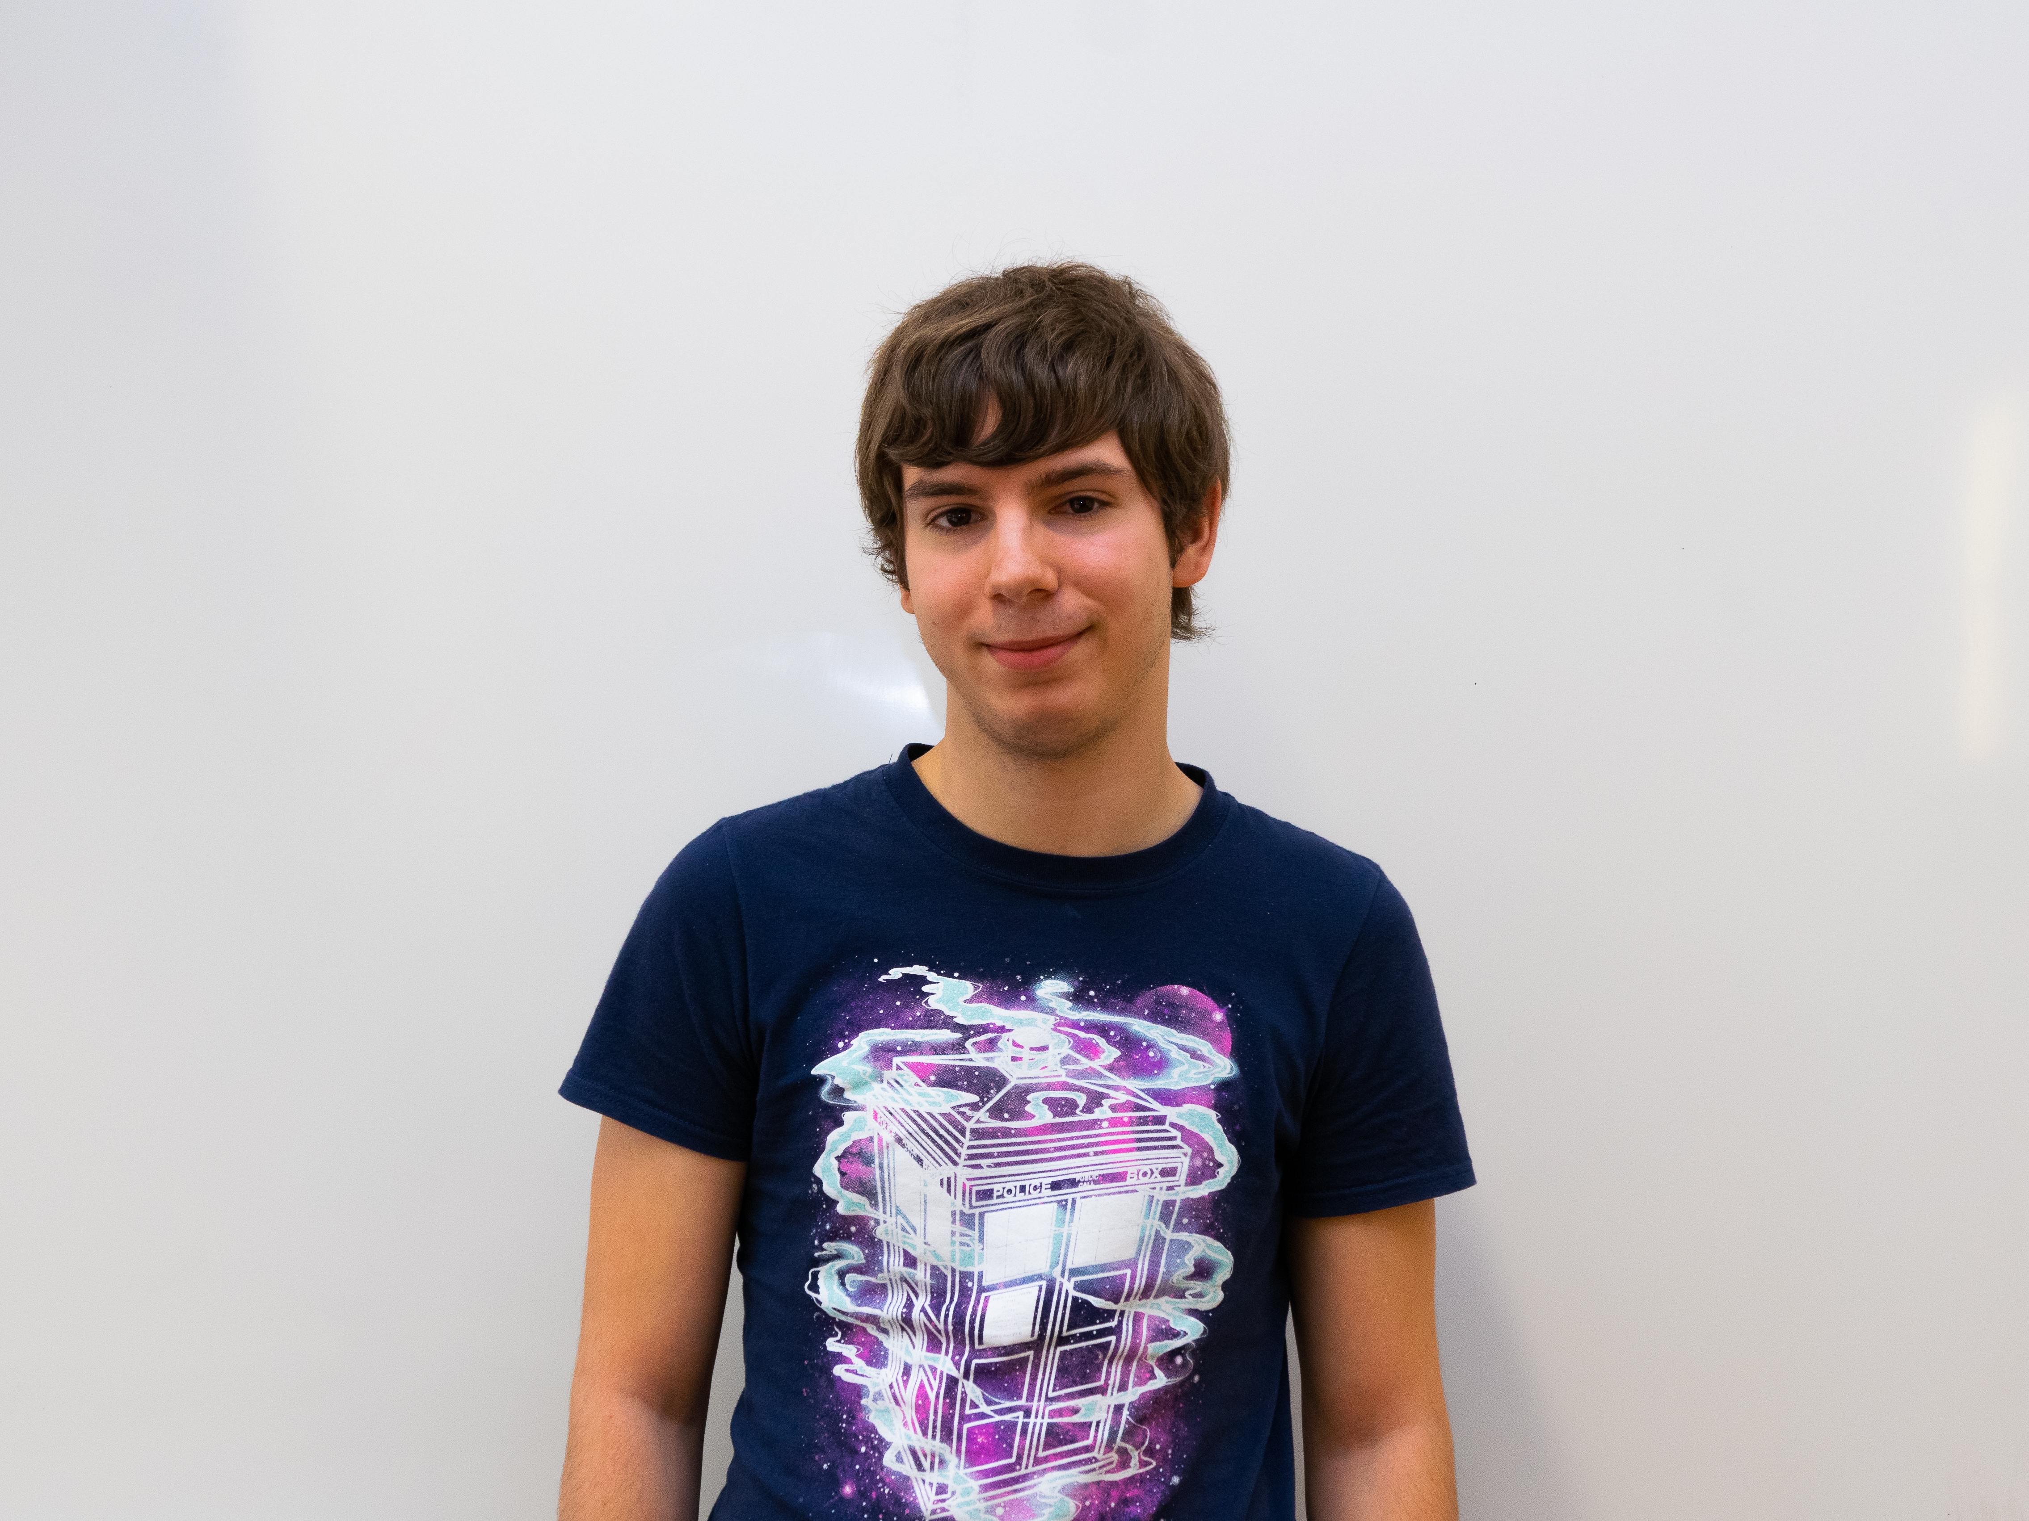
Team
Gregory Koenig
Modeler
Frederic Fleisch
Project manager
Quentin Sommer
Analyst

Slide 5



Organization

Slide 6
Project

Slide 7
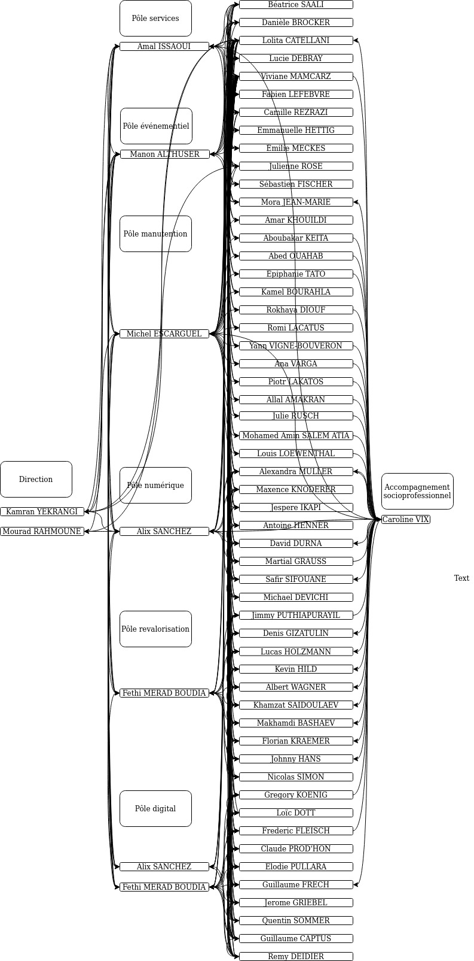
Modelling

Slide 8
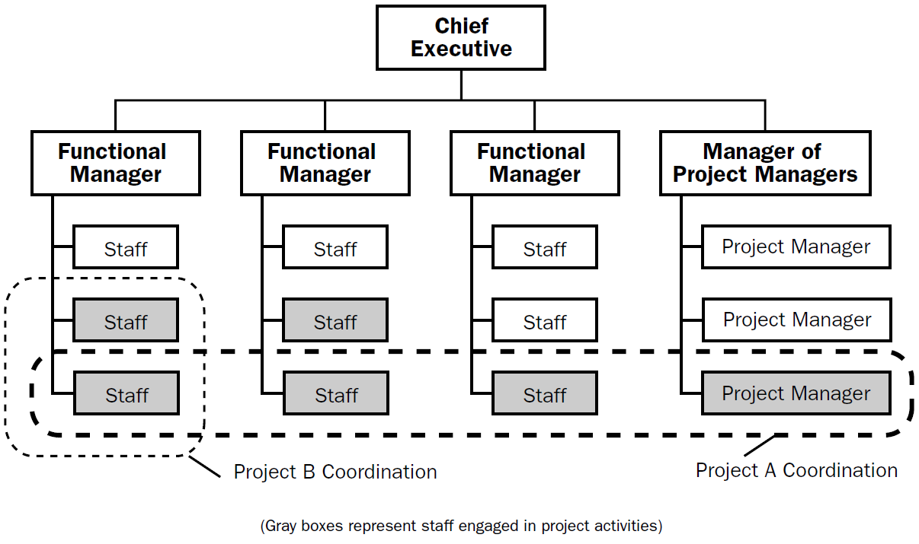
Analysis

Slide 9

Questions

Slide 10
Thank you

